Slide 1
01 Intro to RL

Slide 2

This tutorial is mainly contributed by…
Github
方泽鸣，zemingfang11@gmail.com
张洳源，ruyuanzhang@gmail.com
张洁莹，jieying.zhang@student.uva.nl
部分内容由张洳源老师正在编写的教材《认知行为的计算原理》收录：

Slide 3

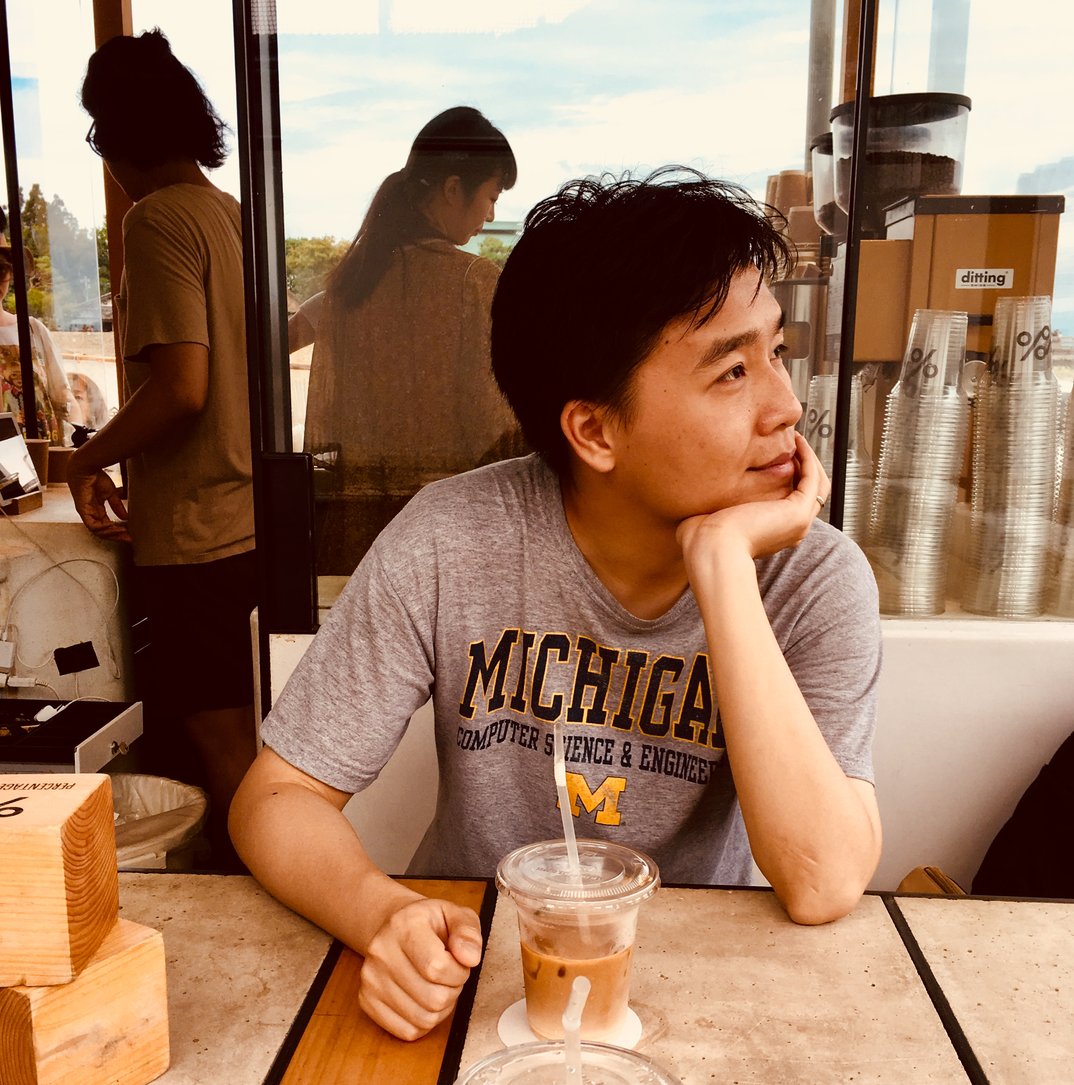




The motivation of this tutorial
CS285: Deep Reinforcement Learning
CS542: Statistical Reinforcement Learning
Shuhuai008: 强化学习
UCL course on RL: Reinforcement Learning
RL theory
Hugging face
Math & CS background
MindRL hub workshop
RW model in psychology & Neuroscience
Hands-on-practice
Progmmaing & computational resources
Q learning in psychology

Slide 4
What we might learn?
Understand that reinforcement learning extends beyond the Rescorla-Wagner model
Implement a classical reinforcement learning algorithms from scratch
Learn how to frame psychological problems within the reinforcement learning framework
Gain acquiantance with some cutting-edge content about planning

Slide 5
Overview
Lecture
Markov Decision Process (MDP)
State, action, reward, transition
Decision making on MDP
Goal, value, poilcy, Q value
Value evaluation
Bellman equation
Policy evaluation
Practice Policy evaluaton

Slide 6
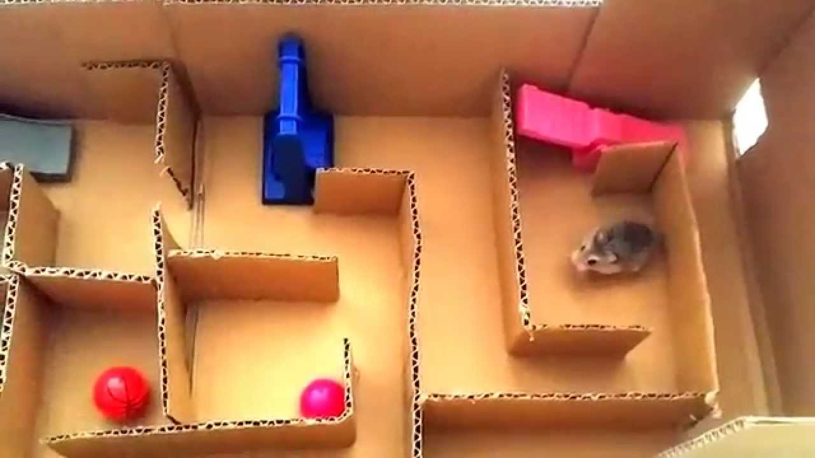

Slide 7
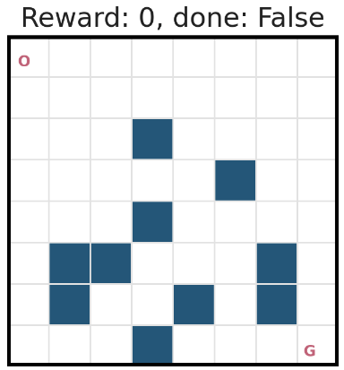
Frozen Lake
Reference:
https://github.com/udacity/deep-reinforcement-learning/blob/master/dynamic-programming/frozenlake.py
20% slippery rate

Slide 8
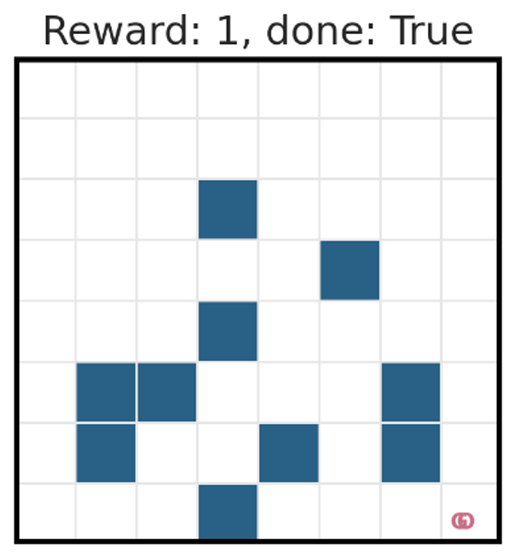
Frozen Lake
Reference:
https://github.com/udacity/deep-reinforcement-learning/blob/master/dynamic-programming/frozenlake.py

Slide 9
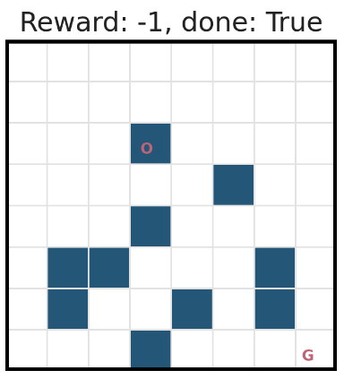
Frozen Lake
Reference:
https://github.com/udacity/deep-reinforcement-learning/blob/master/dynamic-programming/frozenlake.py

Slide 10
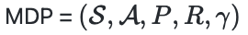
Markov decision process (MDP)
S_{t-1}
S_{t}
S_{t+1}
Why Markov property?
R_{t-1}
R_{t}
R_{t+1}
A_{t-1}
A_{t}
A_{t+1}

Slide 11
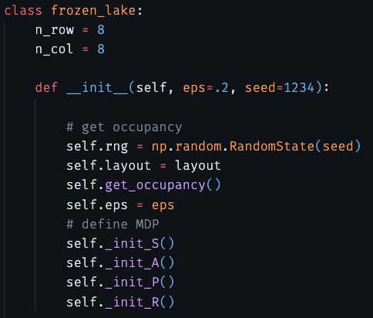
Markov decision process (MDP)

Slide 12
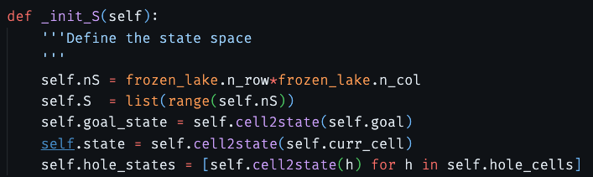
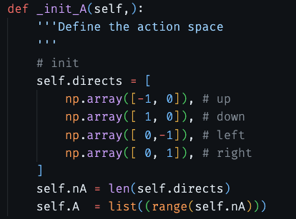
Markov decision process (MDP)

Slide 13
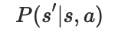
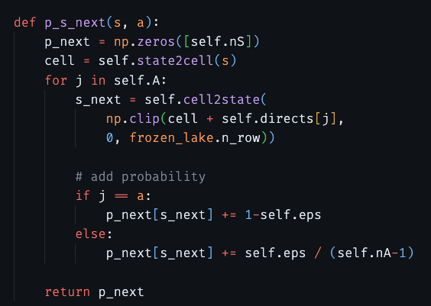
Markov decision process (MDP)

Slide 14
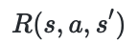
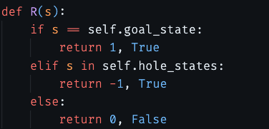
Markov decision process (MDP)

Slide 15
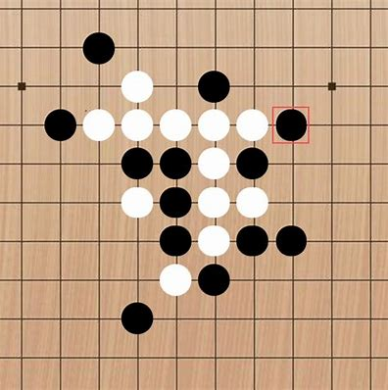
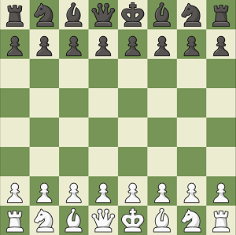

Markov decision process (MDP)

Slide 16
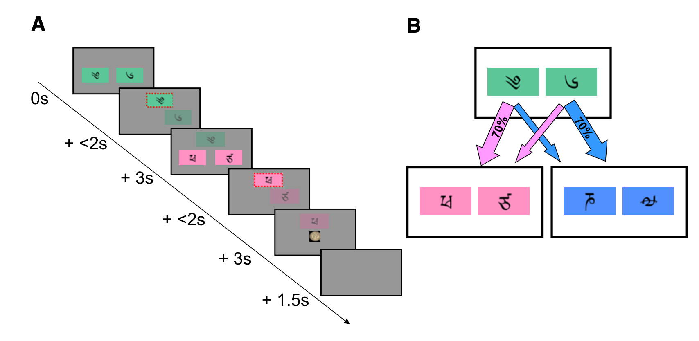
Markov decision process (MDP)
￥9
￥1
￥6
￥4
(Daw, 2011, Neuron)

Slide 17
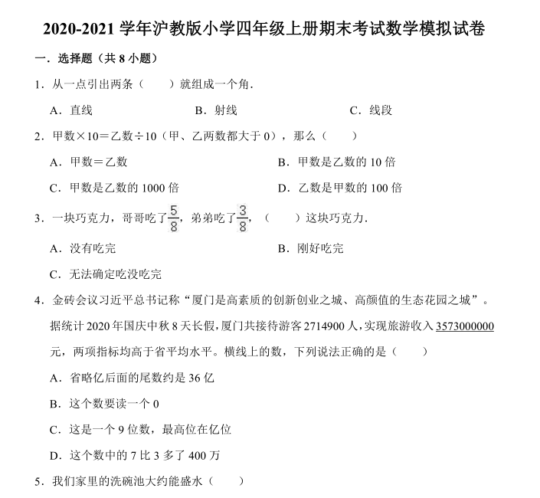

Goal

Slide 18
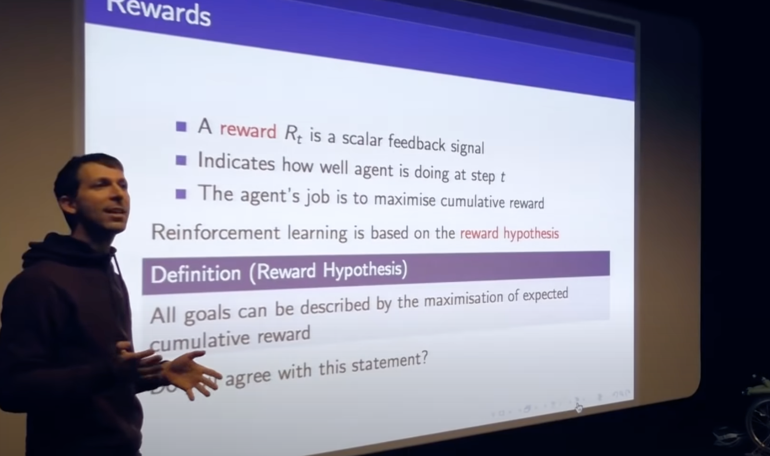
Goal: reward hypothesis
(Silver, 2022, Artificial Intelligence)

Slide 19
Cumulative reward
S_{t-1}
S_{t}
S_{t+1}
R_{t-1}
R_{t}
R_{t+1}
A_{t-1}
A_{t}
A_{t+1}

Slide 20
Expected cumulative reward
S_{t-1}
S_{t}
S_{t+1}
R_{t-1}
R_{t}
R_{t+1}
A_{t-1}
A_{t}
A_{t+1}

Slide 21
Value: expected cumulative reward at a given state
S_{t}
S_{t+1}
S_{t-1}=s
R_{t-1}
R_{t}
R_{t+1}
A_{t-1}
A_{t}
A_{t+1}

Slide 22
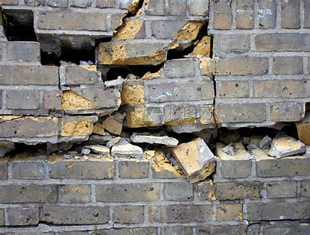
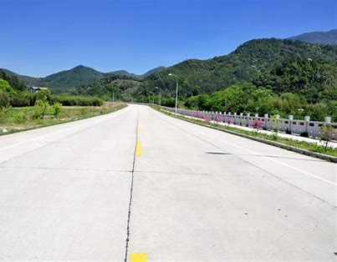
Value: expected cumulative reward at a given state
君子不立危墙之下

Slide 23
Policy
S_{t}
S_{t+1}
S_{t-1}=s
R_{t-1}
R_{t}
R_{t+1}
A_{t-1}
A_{t}
A_{t+1}
A policy maps a state to a distribution of actions

Slide 24
Goal: reward hypothesis

Slide 25
Q Value: expected cumulative reward at a given state and a given action
S_{t}
S_{t+1}
S_{t-1}=s
R_{t-1}
R_{t}
R_{t+1}
A_{t}
A_{t+1}
A_{t-1}=a

Slide 26
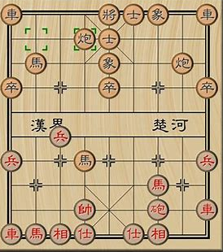
Value evaluation is not easy
要不要读博？
o

Slide 27
Bellman equation
S_{t}=s

Slide 28
Bellman equation
S_{t}=s
A_{t}

Slide 29
Bellman equation
S_{t}=s
S_{t+1}
R_{t}
A_{t}

Slide 30
Bellman equation
S_{t}=s
S_{t+1}
R_{t}
A_{t}

Slide 31
Bellman equation
Correct value evaluation should stasitfy this Bellman equation:
This also applies to the state-action value function (Q function)

Slide 32
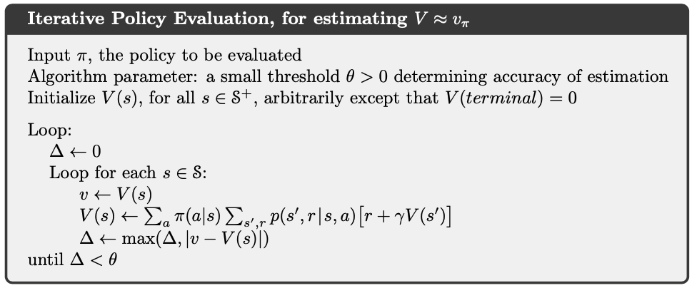

Dynamic programming: poicy evaluation

Slide 33
Summary
Lecture
Markov Decision Process (MDP)
State, action, reward, transition
Decision making on MDP
Goal, value, Q value, poilcy
Value evaluation
Bellman equation
Policy evaluation
Practice Policy evaluaton
Take-home Practice
Frame the two-stage task as a MDP
Derive the Bellman equation for Q-values

